Slide 1

Qiskit Basics
Hack Night Workshop #5!

Slide 2
Quantum Computing: The Basics
Classical bits are represented as 0s and 1s, while quantum bits, or qubits, are probabilistic.
This could mean a 50/50 chance my qubit is 0/1, or any other combo as long as it adds up to 100%! (Until we measure it, when it finally picks a value to be)
This is what’s known as superposition.
Additionally, I could use one qubit to conditionally change another qubit. Example: If qubit A is 1, change qubit B to be 1.
This is what’s known as entanglement.
We can change these probabilities in the same way we change bits, with logic gates (in this case, quantum logic gates)
Notes:
Mention that “superposition” and “entanglement” are just fancy words for simple concepts.

Slide 3
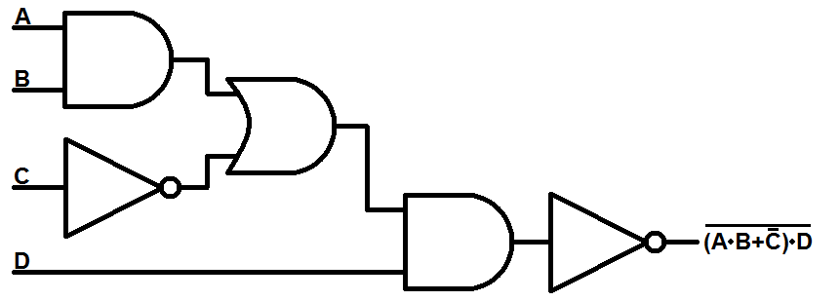
Digital Circuits: A Breakdown
Let’s break down how to read a digital circuit diagram before we look at quantum.
Notes:
MENTION:
How VHDL describes the gates/logic

Slide 4
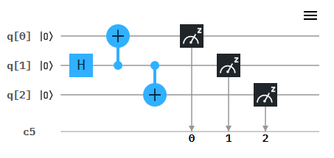
Quantum Circuits: A Breakdown
Let’s break down how to read a quantum circuit diagram…
Notes:
MENTION:
Timeframe
Gates
Measurements
“Depth”

Slide 5

Qiskit: What is it?
Qiskit is a Python library developed by IBM that has many tools for quantum computing.
Qiskit includes tools for:
Creating quantum circuits
Simulating quantum circuits
Both noisy and noiseless
Running circuits on real quantum computers
Qiskit has a TON of learning resources that we’ll provide at the end of this presentation.
Notes:
Mention how this is like the VHDL of QC

Slide 6
Putting it all together…
Let’s make some example circuits on https://quantum-computing.ibm.com/composer
Then let’s use Qiskit to code our own!
https://github.com/delster1/bugSmashers/tree/main/qiskitBasics
Notes:
Mess around on composer, then make the taped coinflip on composer

Slide 7
Resources
Favorite (It’s interactive!)
https://davidbkemp.github.io/QuantumComputingArticle/
https://learning.quantum-computing.ibm.com
https://www.quantum-inspire.com/kbase/introduction-to-quantum-computing
(More math-focused) https://youtube.com/playlist?list=PL8ER5-vAoiHAWm1UcZsiauUGPlJChgNXC&si=UzAjkux3VQI-Hpu3

